Slide 1


Autonomous driving car using AI
AKazi Mainul Kaysar ID-2011615042
Abdullah Al-Galib Id- 1712986642
A.F.M Khairul Amin 2012815642
Md. Waliur Rahman - 2011306042
Group- 03

Slide 2

Introduction to Autonomous Driving
What is Autonomous Driving?
Definition and Overview
This technology allows vehicles to drive themselves, using a combination of sensors, cameras, and AI to interpret data about the environment.
Autonomous driving refers to vehicles equipped with AI systems that can perform necessary driving tasks with little or no human involvement.
Levels of Automation
Importance in Modern Transportation
There are six levels of vehicle automation, ranging from no automation (Level 0) to full automation (Level 5), influencing regulatory frameworks.
Autonomous vehicles can enhance road safety, reduce traffic congestion, and improve mobility for those unable to drive.
Historical Development
The journey to autonomous driving began in the 20th century, driven by advances in computer science and robotics.

Slide 3



Role of AI in Autonomous Driving
1
AI Technologies in Autonomous Cars
2
Machine Learning
Various AI technologies, such as machine learning and computer vision, are essential for processing sensor data in real-time.
Machine learning algorithms enable cars to learn from experiences and improve their driving performance through repeated practice and data analysis.
3
Computer Vision
4
Sensor Fusion
This technology allows vehicles to 'see' and interpret surrounding environments, identifying objects, road signs, and pedestrians effectively.
Combining data from multiple sensors enhances accuracy in environment understanding, crucial for safe navigation.
5
Real-time Decision Making
AI systems are designed to make instantaneous decisions based on sensory input, ensuring responsive and safe driving behavior.

Slide 4




Safety and Ethical Considerations
Safety Measures in Autonomous Vehicles
Testing and Validation
1
2
Extensive testing in varied conditions is essential.
Robust safety protocols, including redundancy systems.
4
3
Safety Protocols and Standards
Ethical Implications
Raises ethical questions about responsibility in critical situations.
Regulatory bodies establish guidelines to promote uniform safety.

Slide 5



Challenges and Limitations
Technical Challenges
Weather Conditions
Developing reliable autonomous systems is complex due to the need for sophisticated algorithms and extensive data processing capabilities.
Adverse weather can significantly affect the functionality of sensors, making it challenging for autonomous systems to operate safely.
Cybersecurity Threats
Regulatory Challenges
Protecting autonomous vehicles from cyberattacks is critical, as unauthorized access could lead to catastrophic failures or accidents.
Creating a regulatory framework that addresses safety, liability, and operational guidelines is essential for widespread adoption and integration into public roads.

Slide 6






Future of Autonomous Driving
Technological Advances
Ongoing research focuses on improving vehicle communication, enhancing AI algorithms, and integrating deeper with smart infrastructure.
Trends and Innovations
Advances in AI, sensor technology, and connectivity continue to evolve, paving the way for safer and more efficient autonomous driving solutions.
2
1
Integration with Smart Cities
3
Autonomous vehicles are poised to be integral to smart city initiatives, optimizing traffic flow and reducing congestion through coordinated systems.
5
Consumer Adoption Rates
4
Initial skepticism exists, but as technology proves reliable, consumer acceptance is anticipated to rise, transforming personal and public transportation.
Market Perspectives
The demand for autonomous vehicles is expected to grow, with major automakers investing heavily in technology development and partnerships.

Slide 7
Tools
1
GitHub
2
Matplotlib
3
google colab
4
jupeter notebook

Slide 8

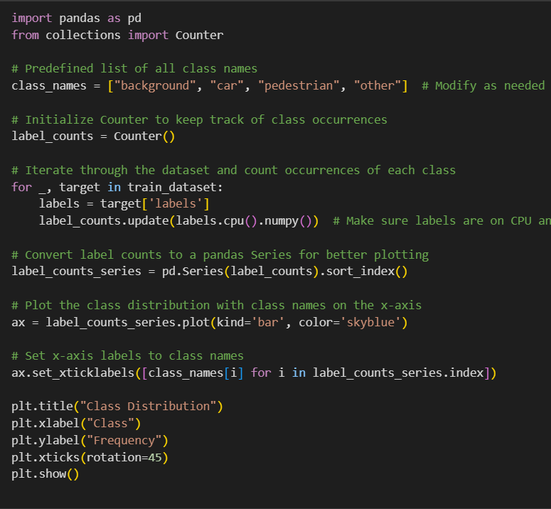
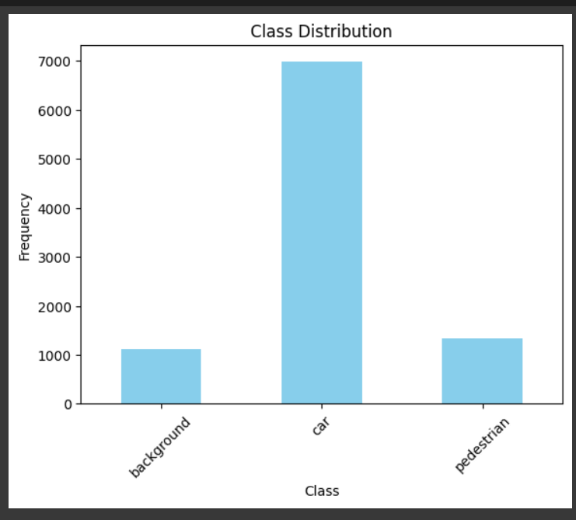
Codes show histogram of our dataset classes
Code

Slide 9

Use the pretrain model . models are :faster rcnn and resnet 50
code

Slide 10
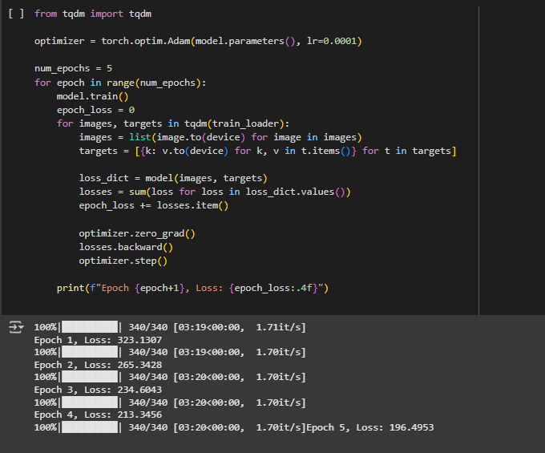
codes for training our modes .. we have run here 5 Epoch

Slide 11

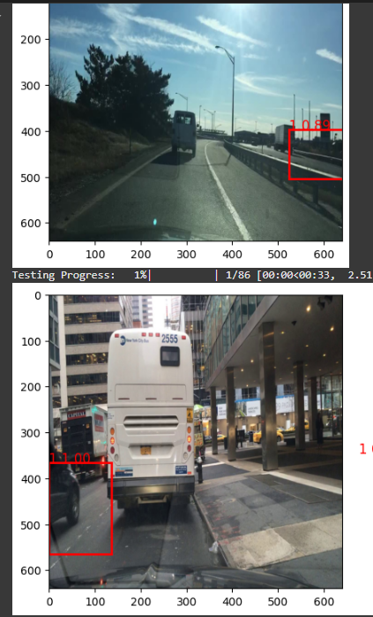
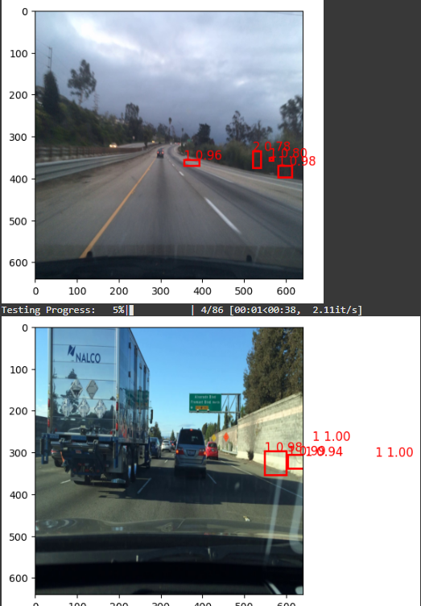
codes for testing on various images

Slide 12

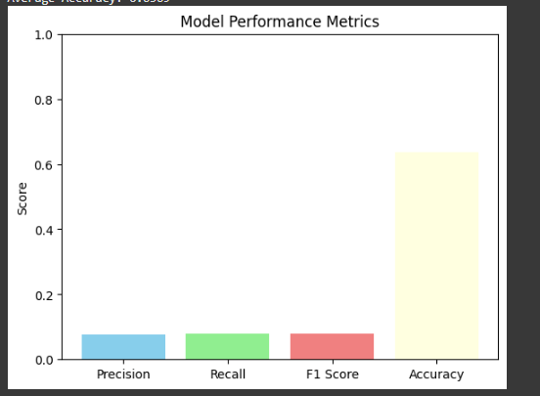

Results and performance metrics

Slide 13
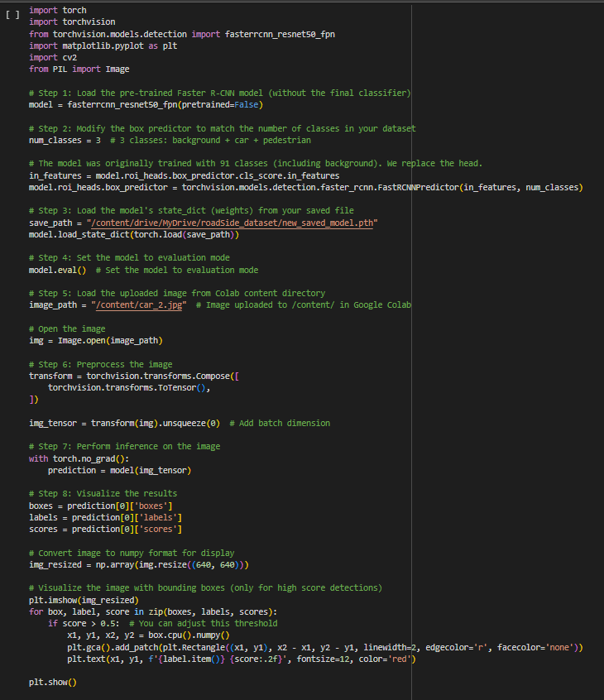
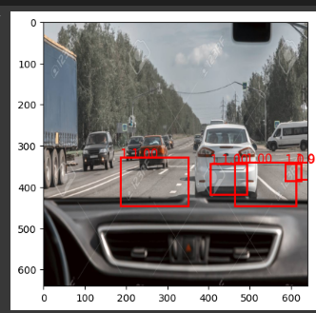
codes for testing on a random image
successfully our model can detect lanes , object ,cars and others from our car’s dashboard.

Slide 14

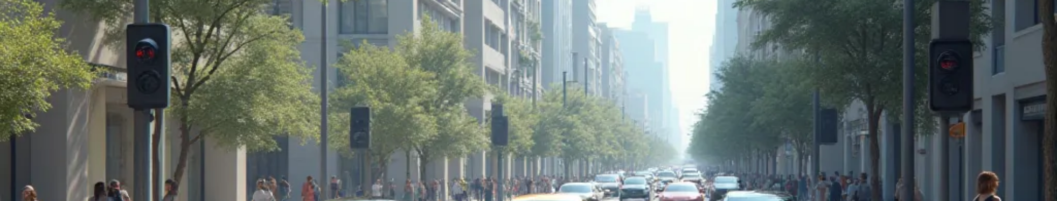
Autonomous Driving Conclusion
1
Revolutionizing Transportation
2
Continuous Advancements
AI-powered vehicles enhance safety and efficiency.
Technological progress supports a smarter future.
3
Consumer Confidence
4
Smart City Integration
Increased adoption expected as technology matures.
Autonomous vehicles will optimize urban mobility.
5
Future Challenges
Regulatory and infrastructure hurdles to overcome.

